Slide 1
CONTENT-SENTIMENT BASED MOVIE RECOMMENDATION SYSTEM
Kevin Albajrami
Furkan Gurcay
Suzana Marsela

Slide 2
ovERVIEW
PROBLEM STATEMENT
PROPOSED SOLUTION
TOOLS AND DATASETS
Methodologies
SOLUTION
Results

Slide 3
OVERVIEW
MOVIE RECOMMENDATION SYSTEMS ARE WIDELYSPREAD BECAUSE OF PLATFORMS LIKE HULU, NETFLIX, DISNEY ETC
THE MAIN IDEA IS TO KEEP THE USERS INTERESTED BY SUGGESTIING WHAT ELSE CAN THEY WATCH

Slide 4
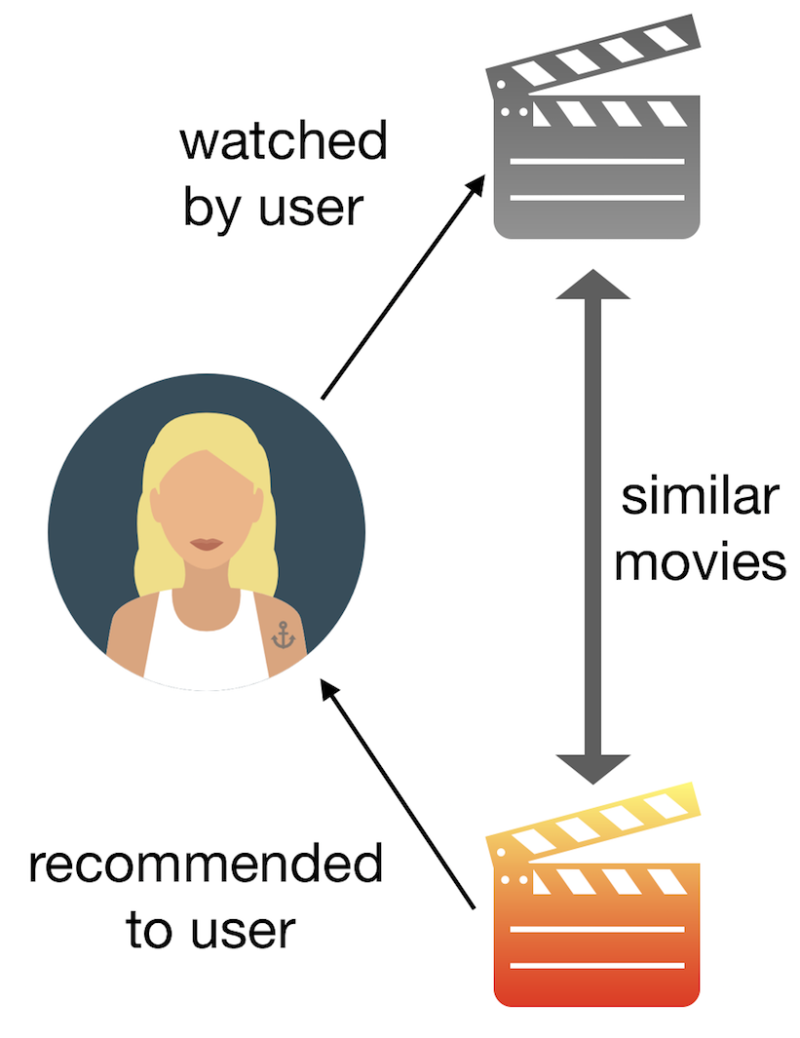
Proposed solution
Content based recommendation systems
Suggest movies based on similarities
If user likes movie A, And movie A is similar to movie B then user may like movie B

Slide 5
Tools and Datasets
Datasets: the movies dataset from Kaggle(6800 titles, actors, directors, genre)
Manually generated dataset to imitate movie reviews
Libraries used:
Numpy
Pandas
NLTK
Blobber
Naïve Bayes analyzer

Slide 6
Methodologies
TF-IDF to score words based on their appearance on the movie entries
Cosine Similarity to compare movie vectors
Fuzzy logic description of data
Naive Bayes analyzer to score the reviews

Slide 7
Content similarity – fuzzy logic
TF-IDF to score words, less appearing words have a higher score
Cosine Similarity for vector comparison (creates n dimensional space and calculate the distance based on the angel between the vectors)
The returned result is a list with the scored comparison
A certain amount (highest ranked)of these movies are sent for sentiment analyses

Slide 8
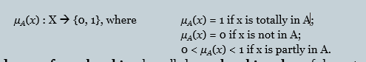
Fuzzy description
Movies similarity is ranked as below:
1- Movies are extremely similar (the same)
0- Movies are entirely different
0-1 Movies are similar to a certain degree

Slide 9
What Is Natural Language ProcessIng?
Natural Language Processing is a branch of artificial intelligence that deals with the interaction between computers and humans using the natural language.
The ultimate objective of NLP is to read, decipher, understand and make sense of the human languages in a manner that is valuable.
Most NLP techniques rely on machine learning to derive meaning from human languages.

Slide 10
Usage areas of NLP
Sentiment Analysis
Chatbots
Customer Service
Managing the Advertisement Funnel
Market Intelligence

Slide 11
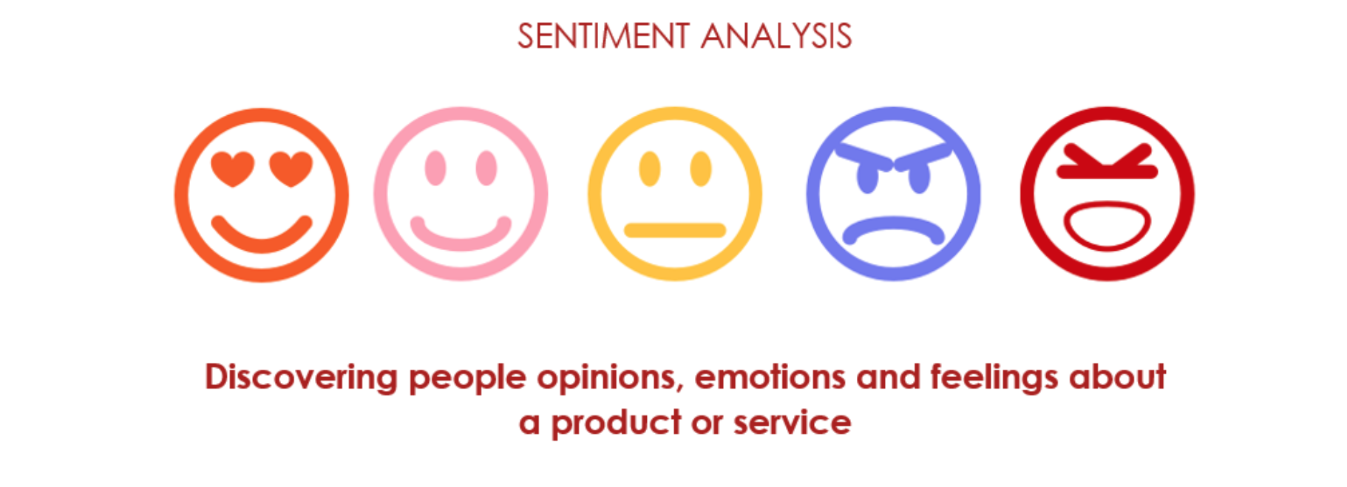
SentIment AnalysIs
Mostly used on the web & social media monitoring, Natural Language Processing is a great tool to comprehend and analyse the responses to the business messages published on social media platforms. It helps to analyse the attitude and emotional state of the writer (person commenting/engaging with posts). This application is also known as opinion mining. It is implemented through a combination of Natural Language Processing and statistics by assigning values to the text (positive, negative or neutral) and in turn making efforts to identify the underlying mood of the context (happy, sad, angry, annoyed, etc.)

Slide 12
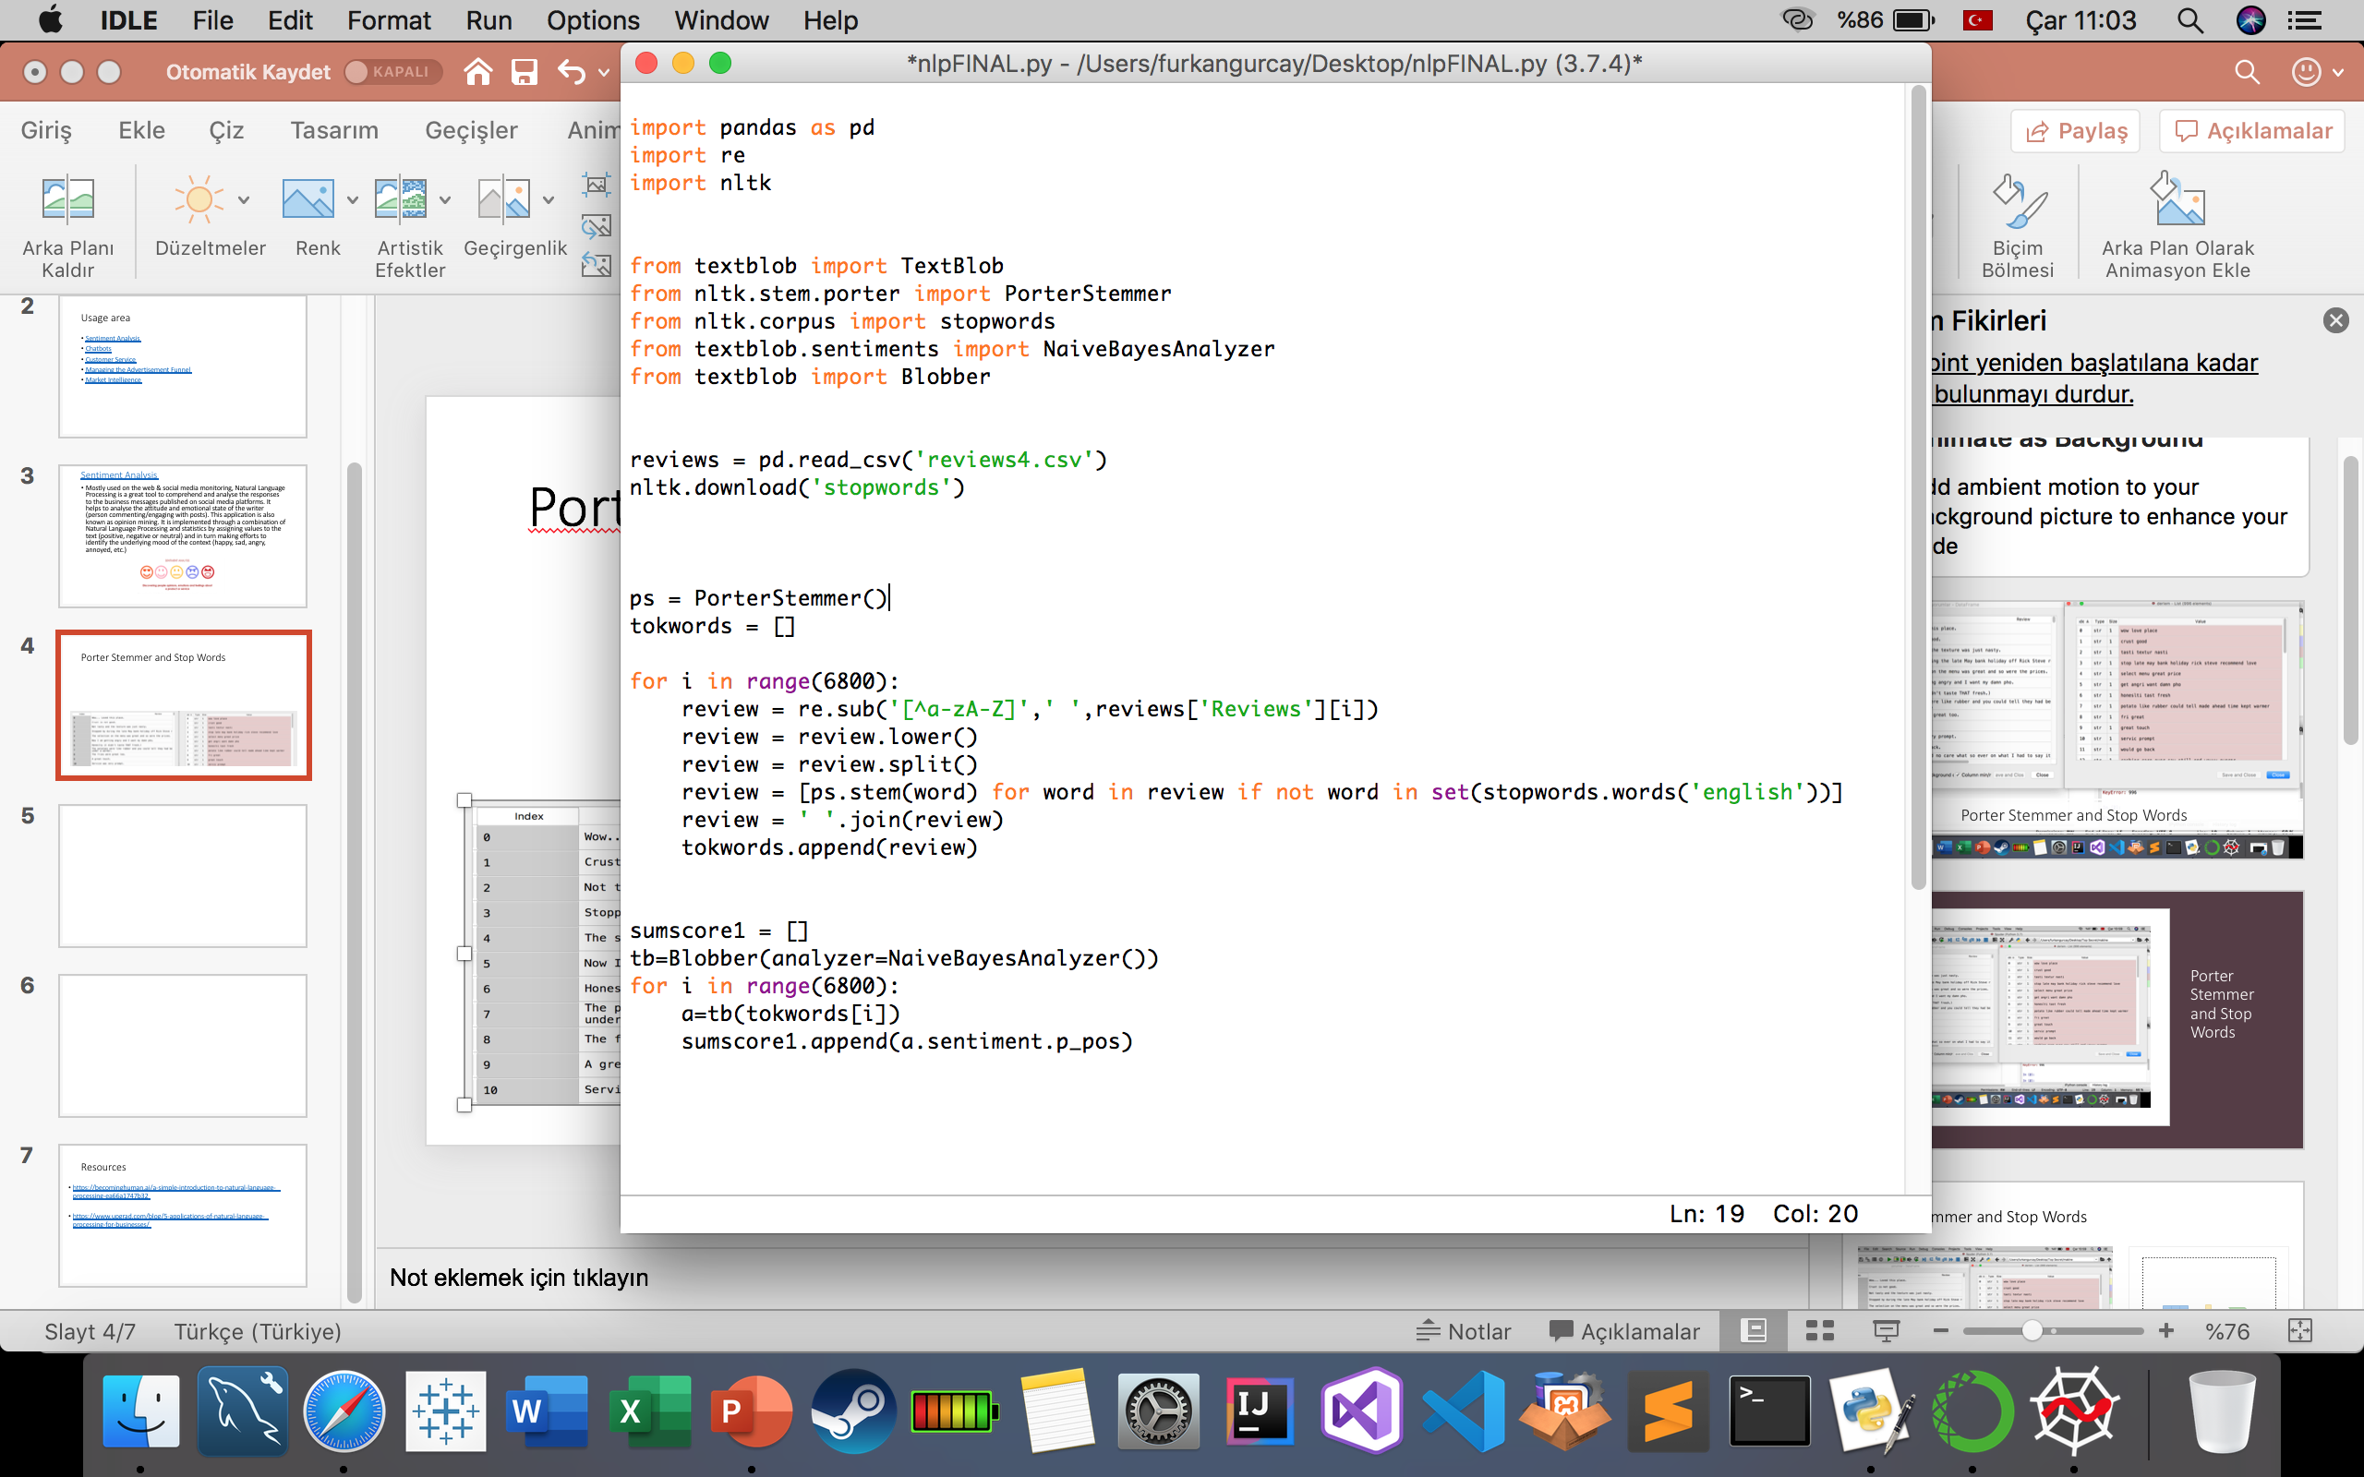
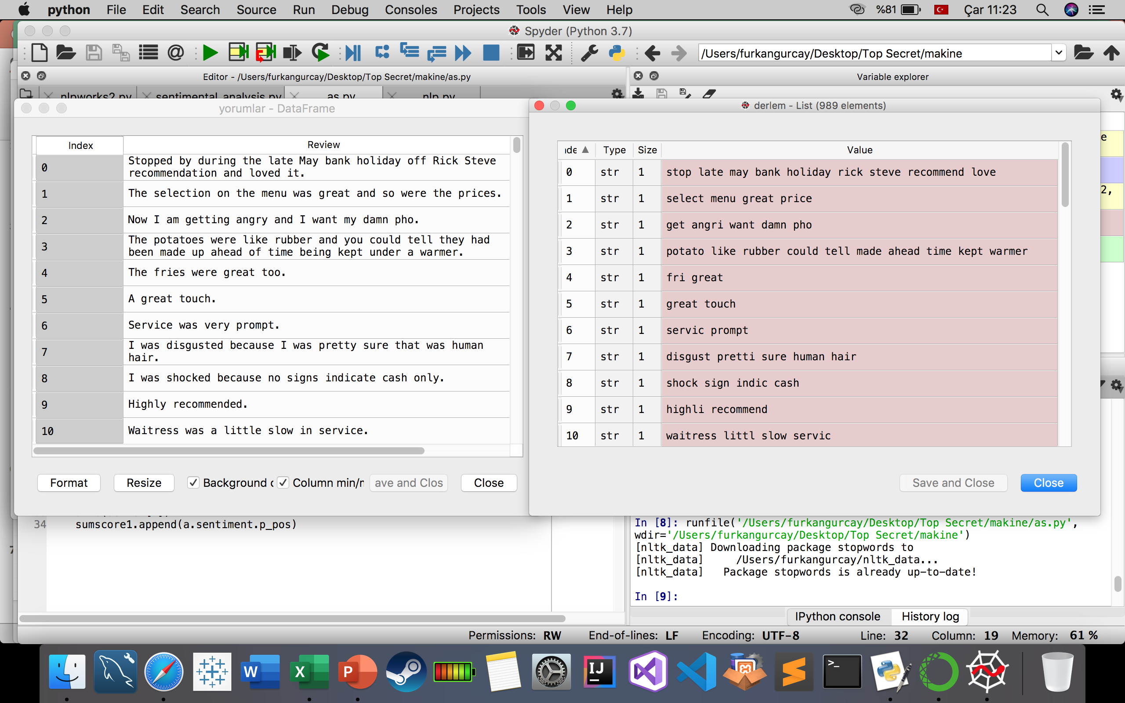
Porter Stemmer and Stop Words (PreprocessIng)
Example:

Slide 13
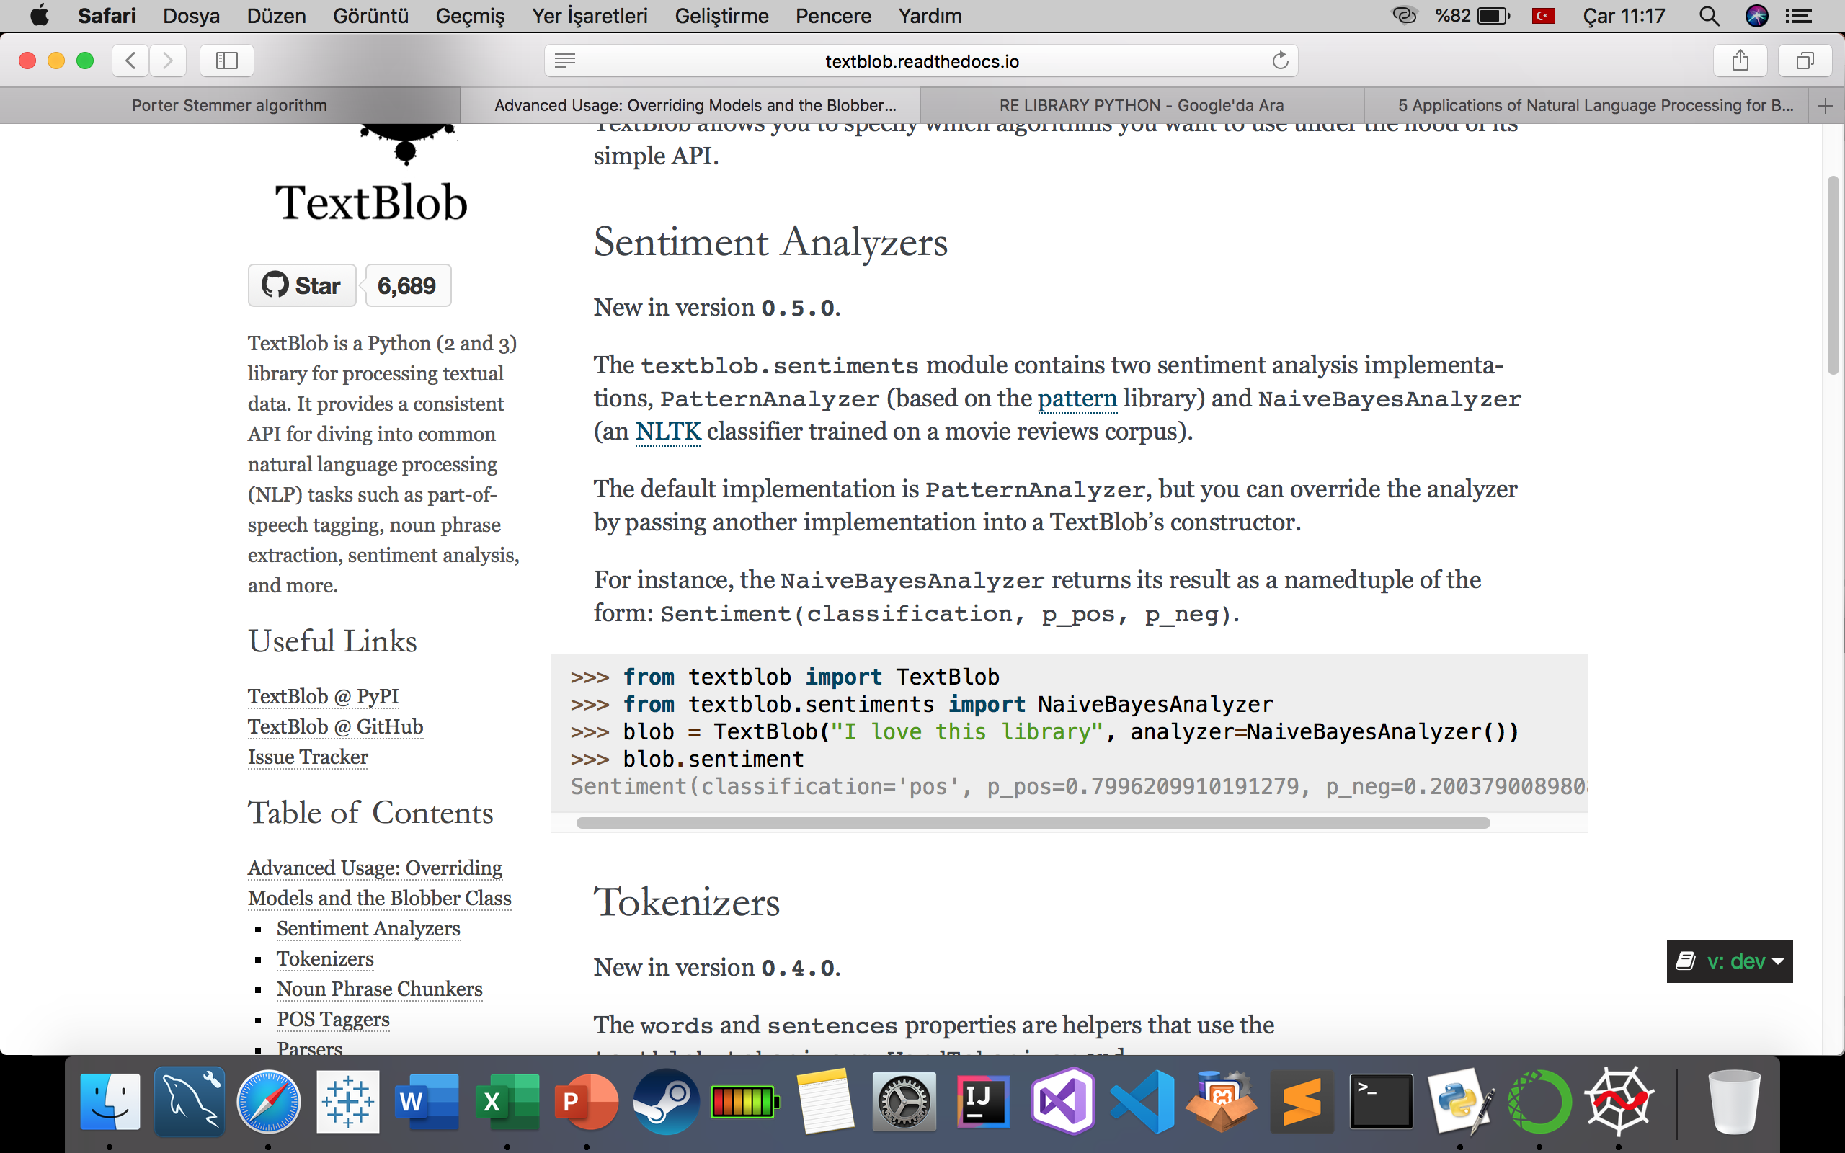
NaIve Bayes Analyzer

Slide 14
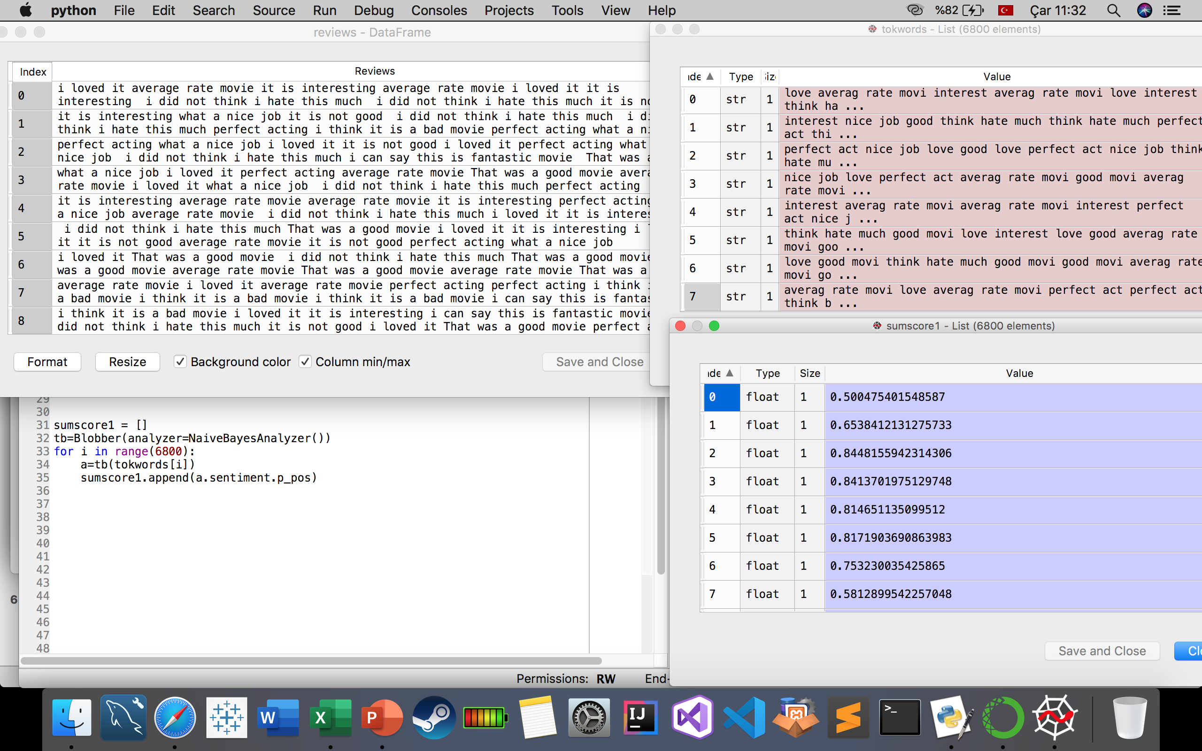

Slide 15
Results
After the content processed movies are sent in for sentiment analyses a list of movies is returned
This list contains THE MOST SIMILAR movies RANKED from BEST TO WORST based on the sentiment analyses.

Slide 16
Resources
https://becominghuman.ai/a-simple-introduction-to-natural-language-processing-ea66a1747b32
https://www.upgrad.com/blog/5-applications-of-natural-language-processing-for-businesses/
https://textblob.readthedocs.io/en/dev/advanced_usage.html

